Slide 1
Battle of Neighborhoods
Indian restaurant in Central Toronto

Slide 2
Problem Statement
Select the best neighborhood to open Indian restaurant etc. in central Toronto.
Understanding the similarities and differences between the neighborhoods using Unsupervised K-Mean Clustering Algorithm

Slide 3
Objective
Collecting Neighborhood’s top trending venues using Foursquare API(Beautiful Soup, http request)
Forming neighborhood clusters based on venue categories using unsupervised k-mean clustering algorithm(sklearn)
Identifying and understanding the similarities and differences between two chosen neighborhoods to retrieve more insights and to conclude with ease which neighborhood wins over other.

Slide 4
Python packages and Dependencies:
Pandas Library for Data Analysis
NumPy Library to handle data in a vectorized manner
JSON Library to handle JSON files
Geopy To retrieve Location Data
Requests Library to handle http requests
Matplotlib Python Plotting Module
Sklearn Python machine learning Library
Folium Map rendering Library

Slide 5
Work flow
Web Scraping and Data Wrangling
Top Trending Places Extraction and Clustering
Decision Making based on the clustered neighborhoods and population distribution.

Slide 6
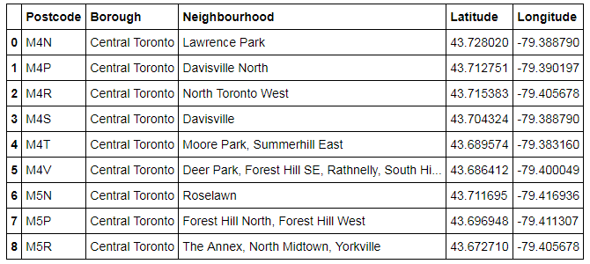

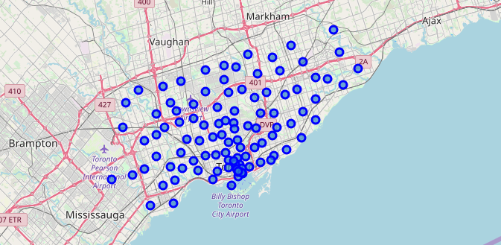
Web Scraping and Data Wrangling
Beautiful Soup
Coordinates of neighborhood
Collecting Neighborhood/Postal code
https://en.Wikipedia.org./wiki/List_of_postal_codes_of_Canada:_M
To Collect Geographical Data
Folium Visualization for Central Toronto neighborhood

Slide 7

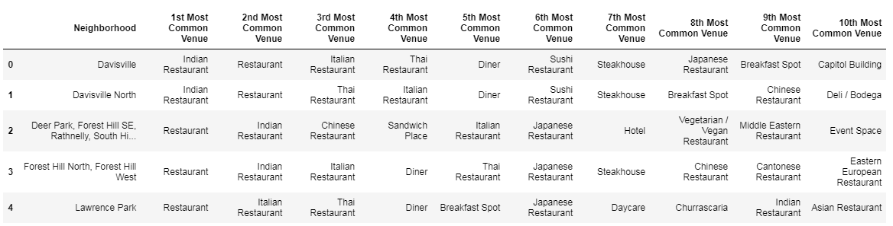
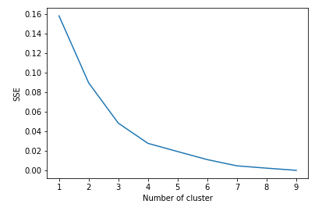
Venues Extraction using Four Square API and Clustering
Four Square API Calls to Collect Neighborhood Venue Category and location coordinates
Cluster 1
One Hot Encoding to Convert Labels into Numbers
Venues Grouped by Neighborhood
K-Means Clustering
Cluster 2
Elbow Method
Cluster 3
Cluster 4

Slide 8
Elbow Criterion Method
The idea behind elbow method is to run k-means clustering on a given dataset for a range of values of k and for each value of k, calculate sum of squared errors (SSE). After that, plot a line graph of the SSE for each value of k. Here we selected four different cluster from Elbow criteria.

Slide 9
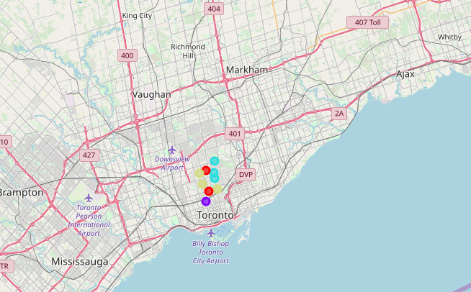
Neighborhood Clusters

Slide 10






Neighborhood 1
Neighborhood 2
Decision Making
Population Distribution Analysis
Cluster Analysis
Probable Indian restaurant

Slide 11
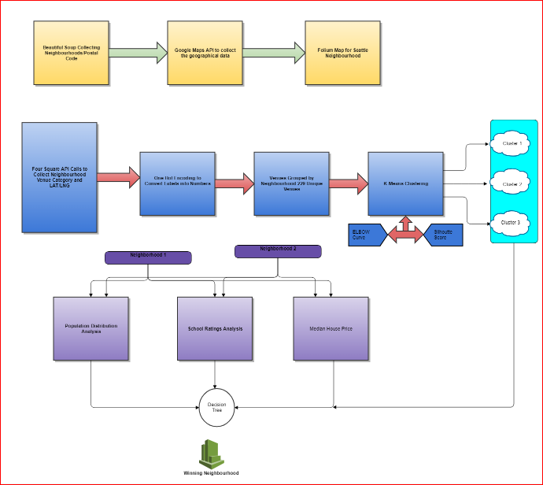
Complete Workflow

Slide 12
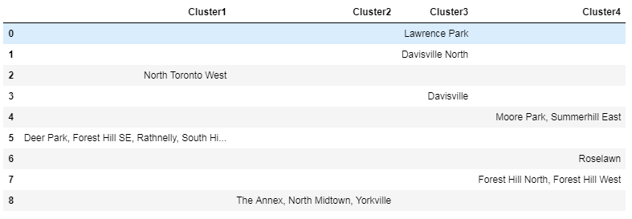
Indian restaurant in central Toronto

Slide 13
conclusion
From the analysis we can concludes that,
as per population distribution and cluster analysis we can suggest opening new Indian restaurant in neighborhood area in and around North Midtown or Yorkville areas.
Hence North Midtown or Yorkville is best options!

